Slide 1
Tests on SBD-STM algorithm

Slide 2
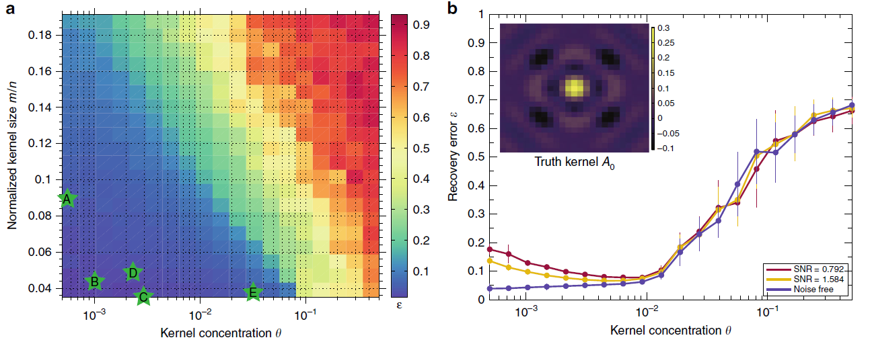
Effectiveness of the algorithm in the parameter space
Concentration of the scatters: theta θ (density of 1’s in the activation map)
Size of kernel: n= N*N
Size of observations: m = M*M
Area ratio: n/m
Sky C. Cheung etal (2020)

Slide 3
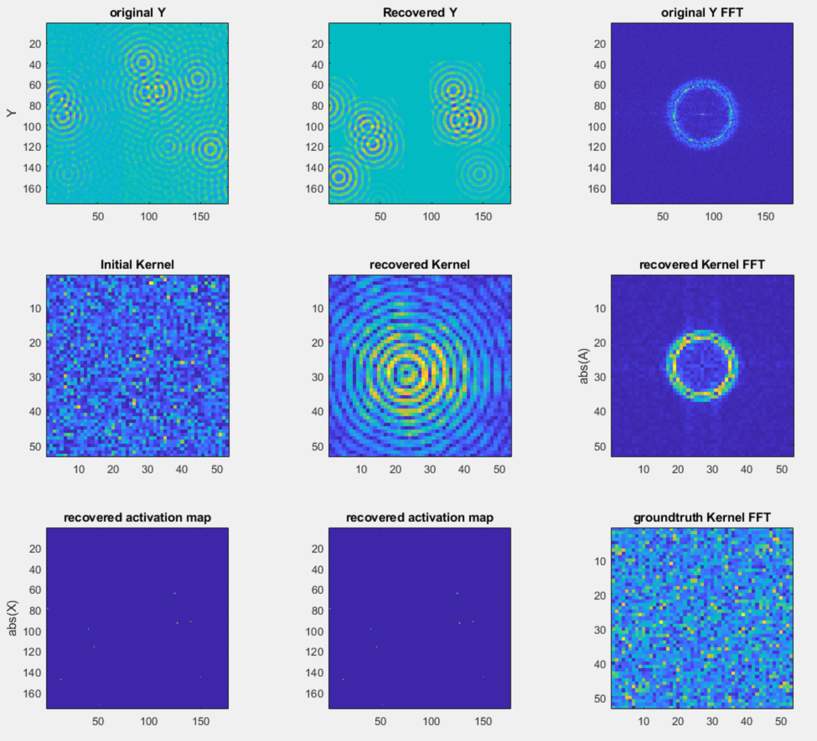
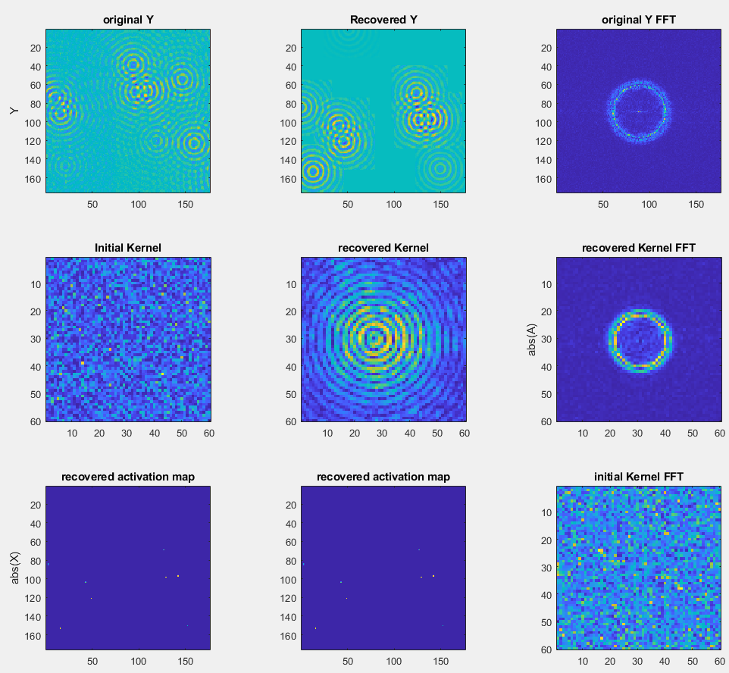
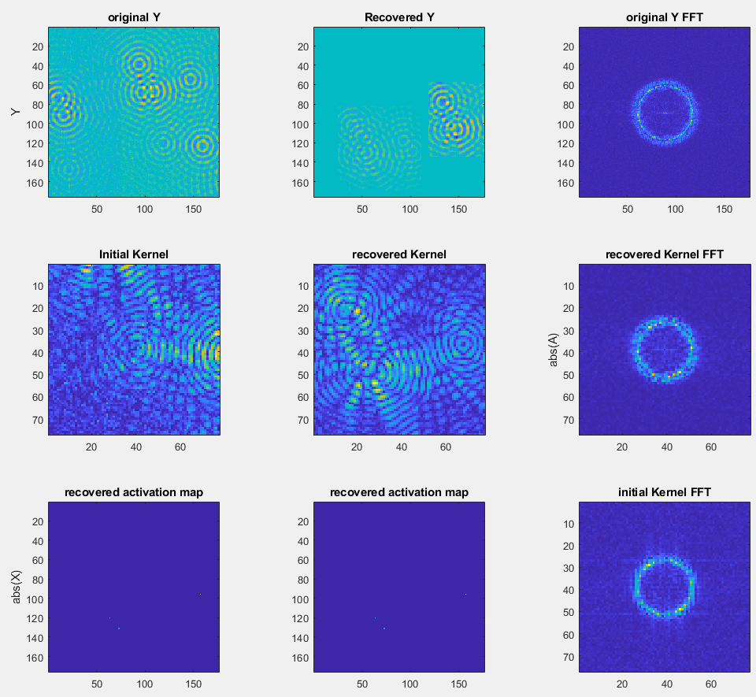
Test on the area ratio vs effectiveness
Observation size = [176 176]
Observation size = [176 176]
Observation size = [176 176]
Kernel size = [53 53]
Kernel size = [60 60]
Kernel size = [77 77]

Slide 4
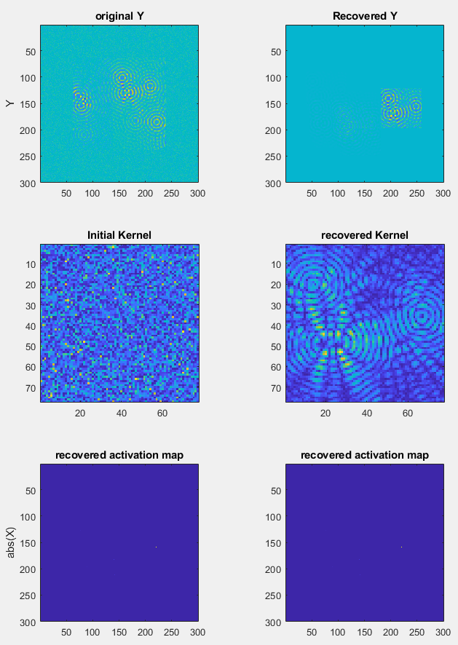
Test on the area ratio vs effectiveness
Padding with background mean and variance
Observation size = [176 176]
Observation size = [176 176]
Observation size = [300 300]
Kernel size = [60 60]
Kernel size = [77 77]
Kernel size = [77 77]

Slide 5
Test unpadded data with bigger lambda
Observation size = [176 176]
Observation size = [176 176]
Observation size = [300 300]
Kernel size = [60 60]
Kernel size = [77 77]
Kernel size = [77 77]

Slide 6
Multi-kernel development

Slide 7
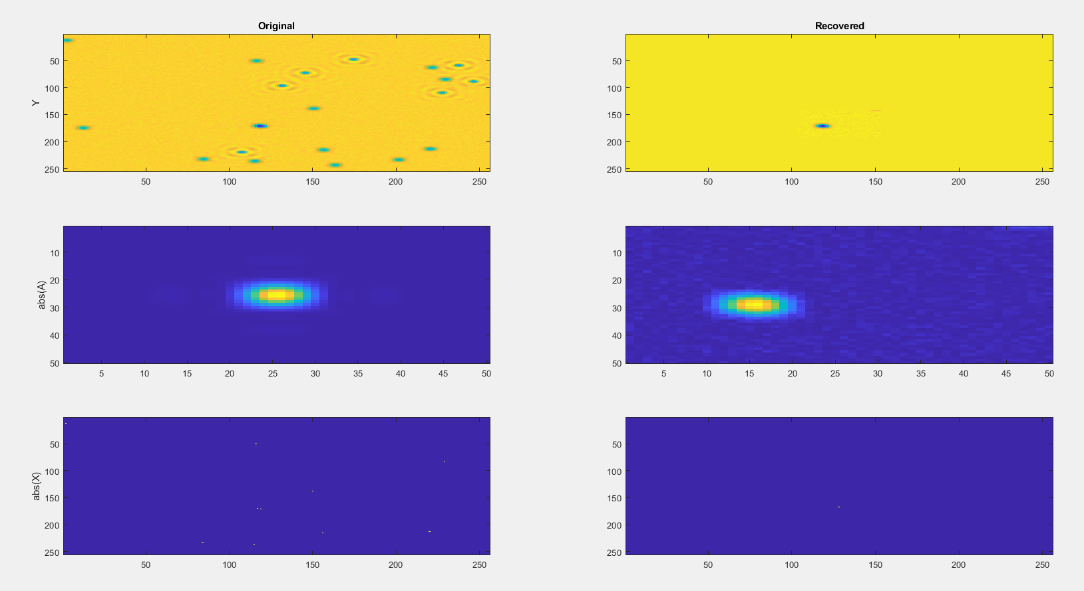
Edge case collections

Slide 8
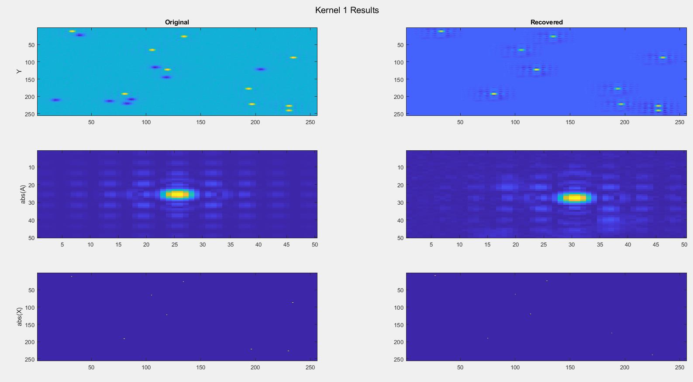
Result_1st working run

Slide 9
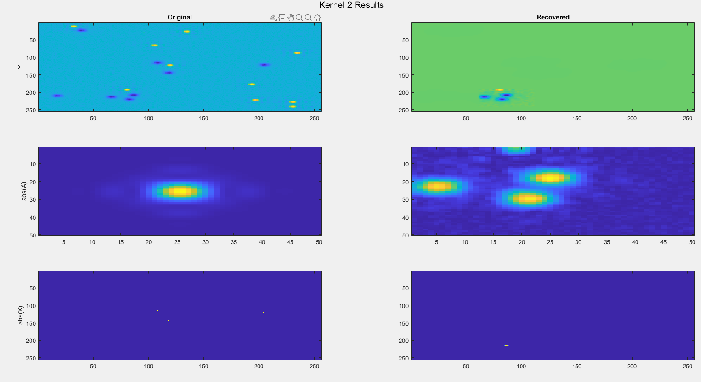
Result_1st working run

Slide 10
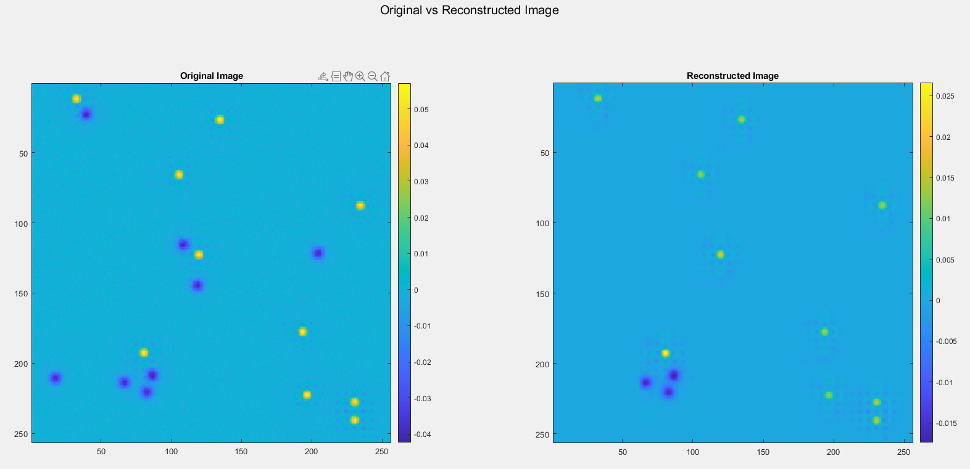
Result_1st working run

Slide 11
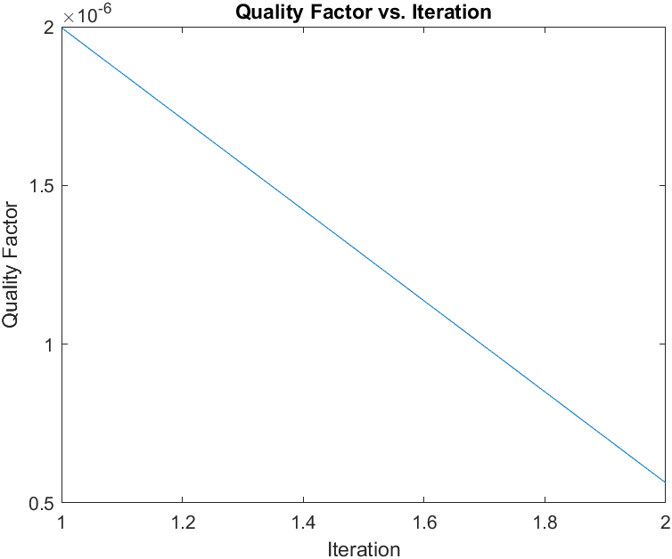
Result_1st working run

Slide 12
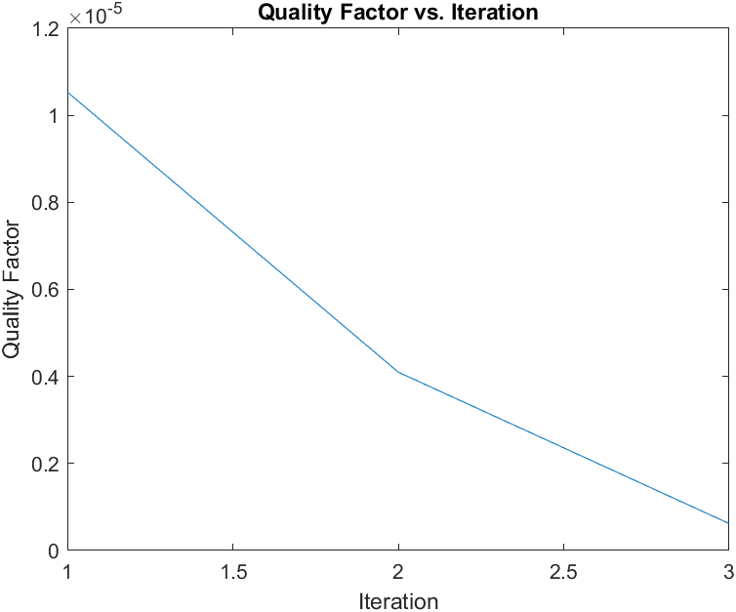
Result_2nd working run

Slide 13
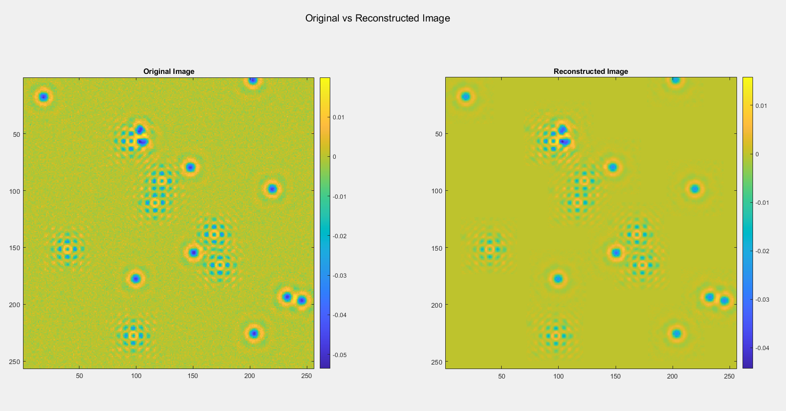
Result_2nd working run

Slide 14
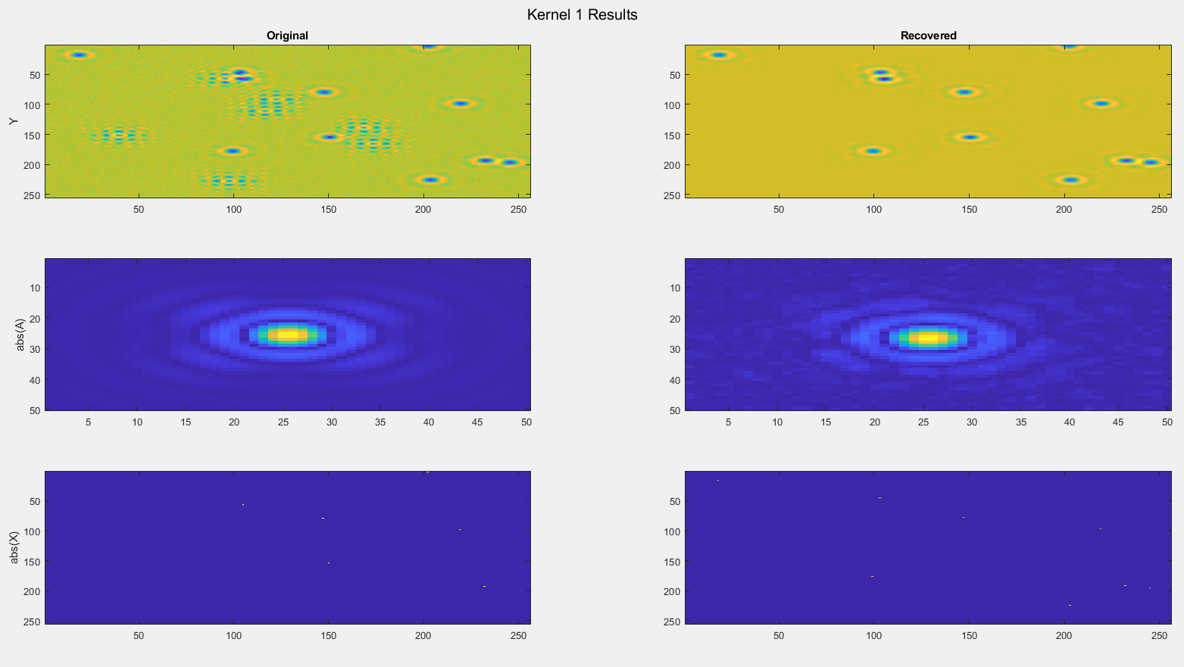
Result_2nd working run

Slide 15
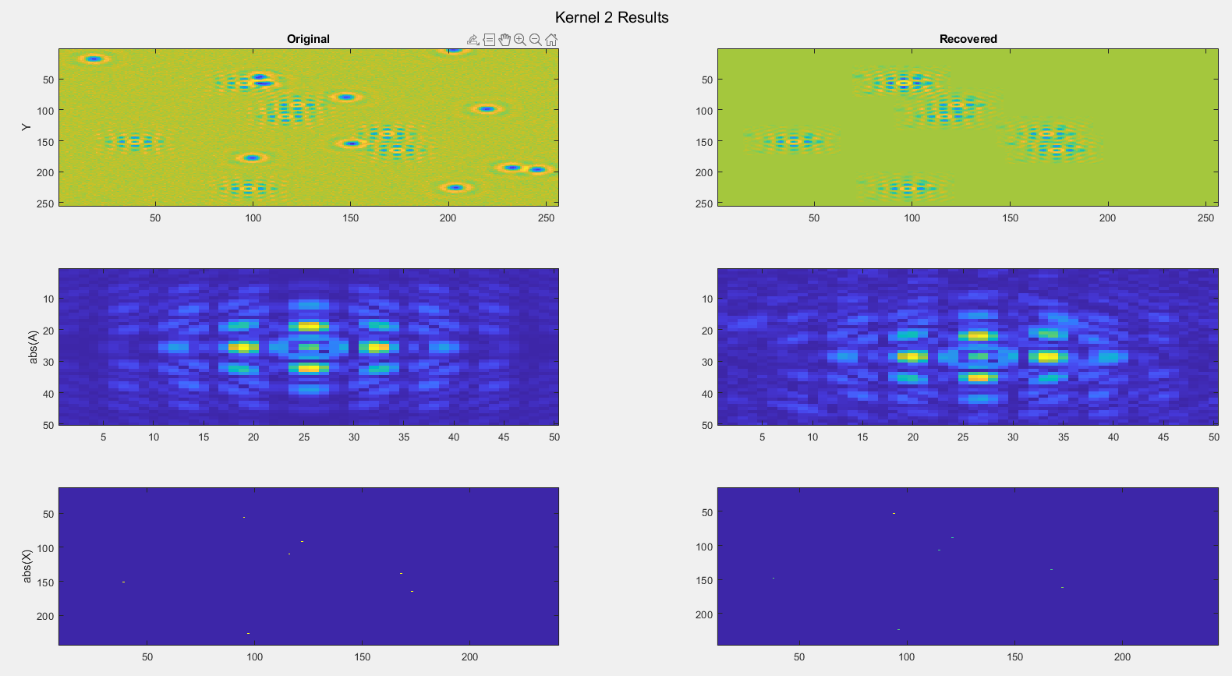
Result_2nd working run

Slide 16
Result_2nd working run

Slide 17
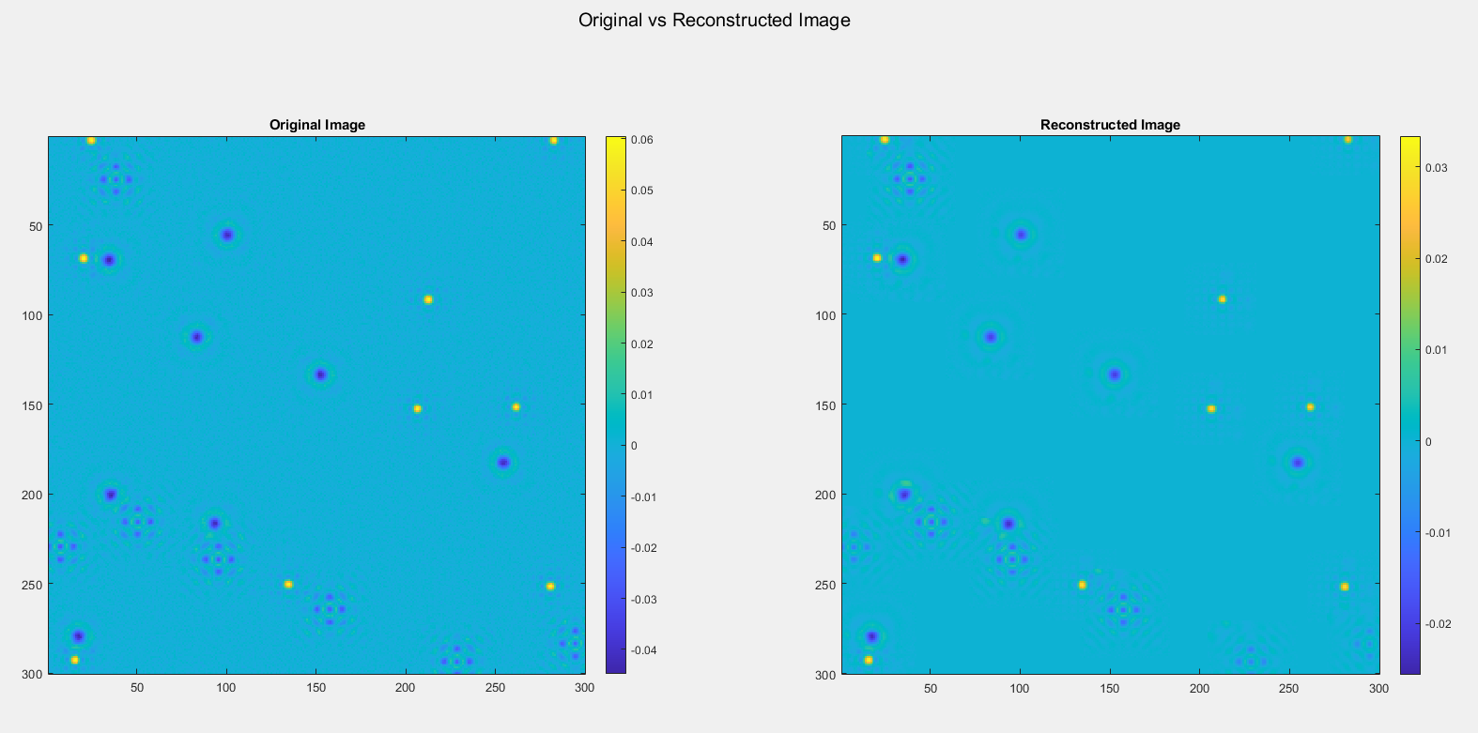
Scaling test:
MAXit = 3

Slide 18
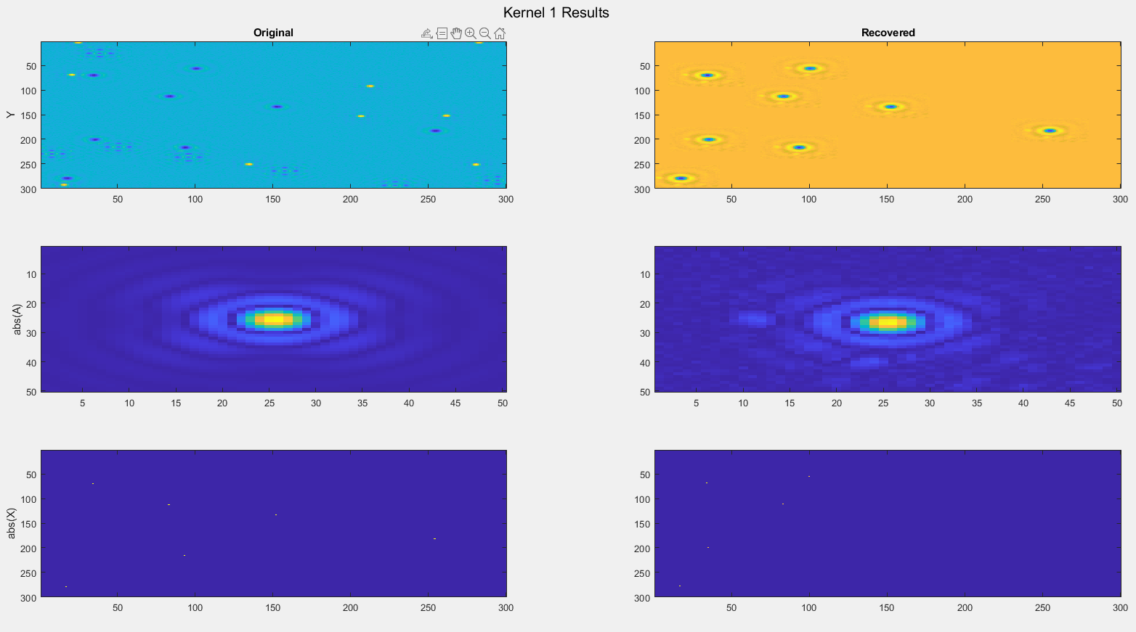
Scaling test:
MAXit = 3

Slide 19
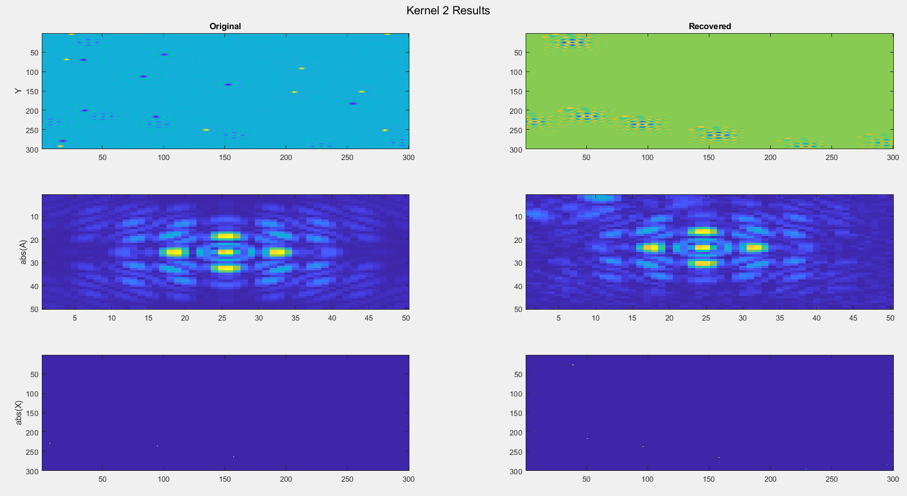
Scaling test:
MAXit = 3

Slide 20
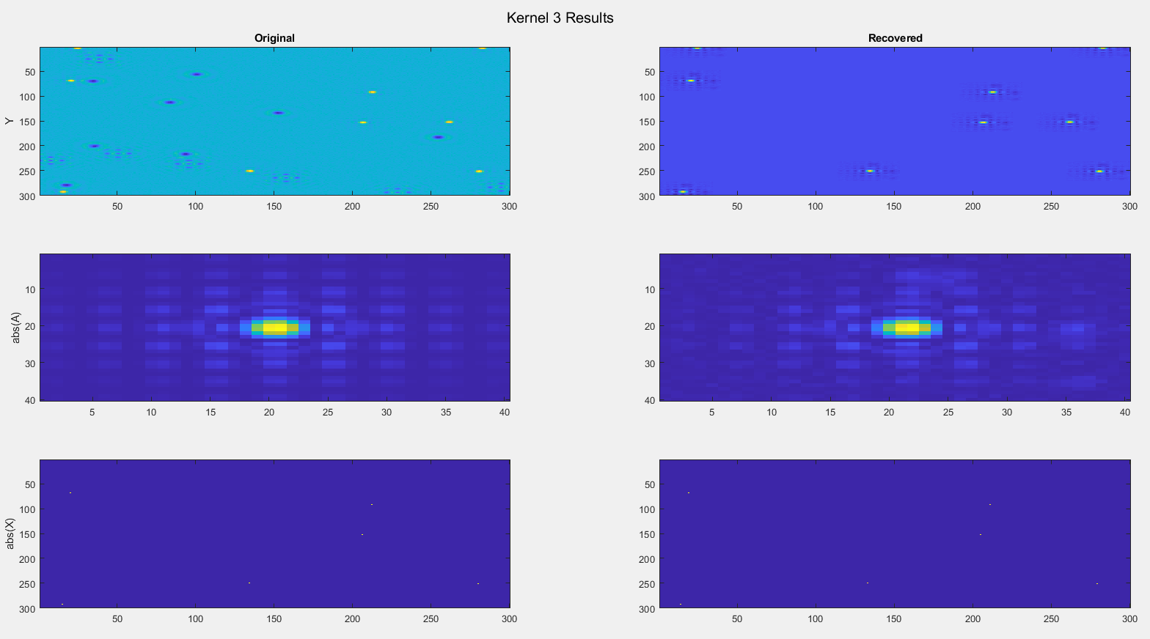
Scaling test:
MAXit = 3

Slide 21
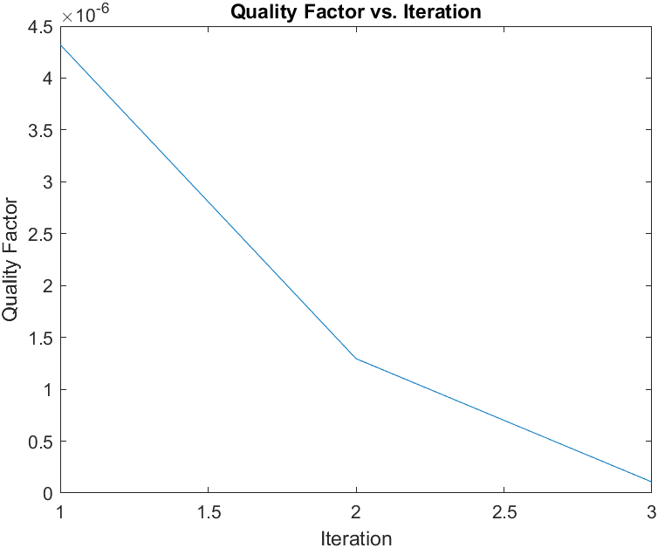
Scaling test:
MAXit = 3

Slide 22
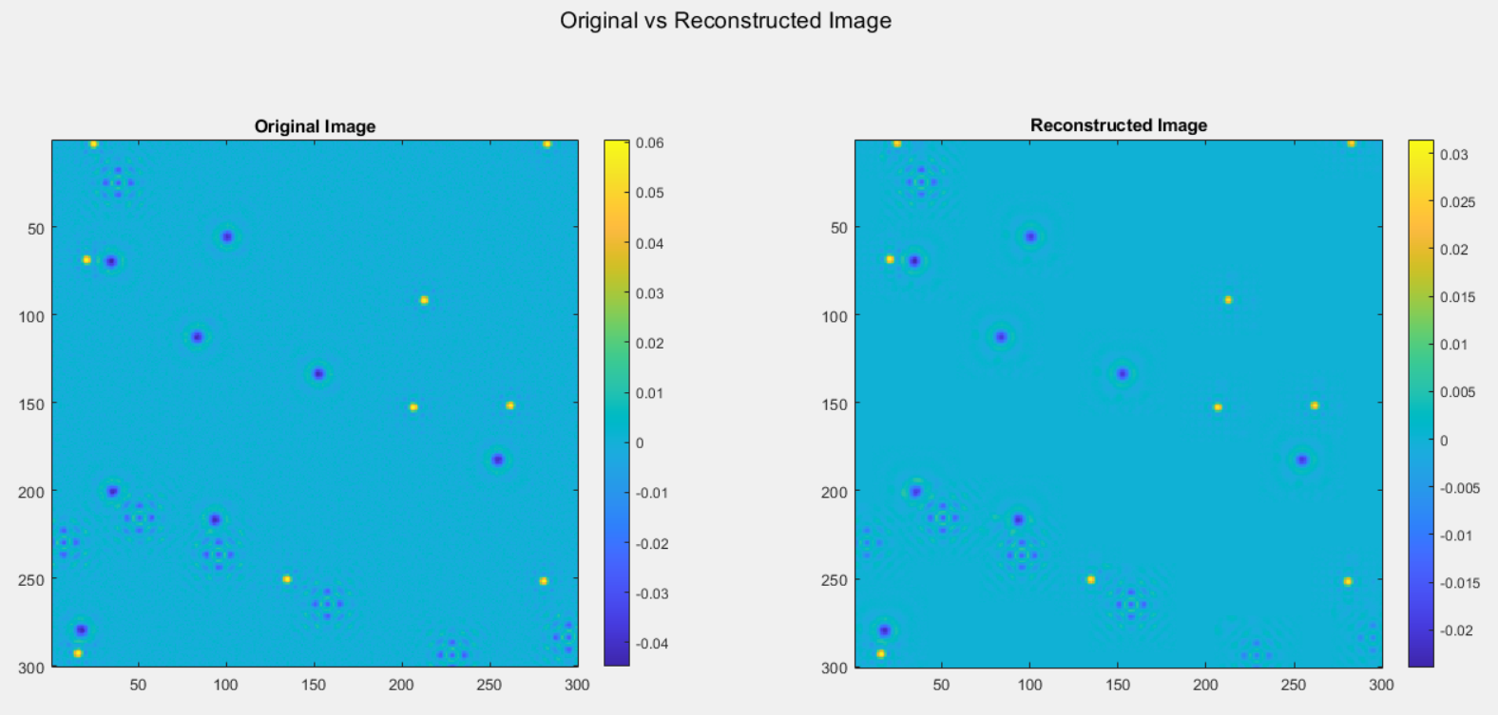
Scaling test:
MAXit = 100

Slide 23
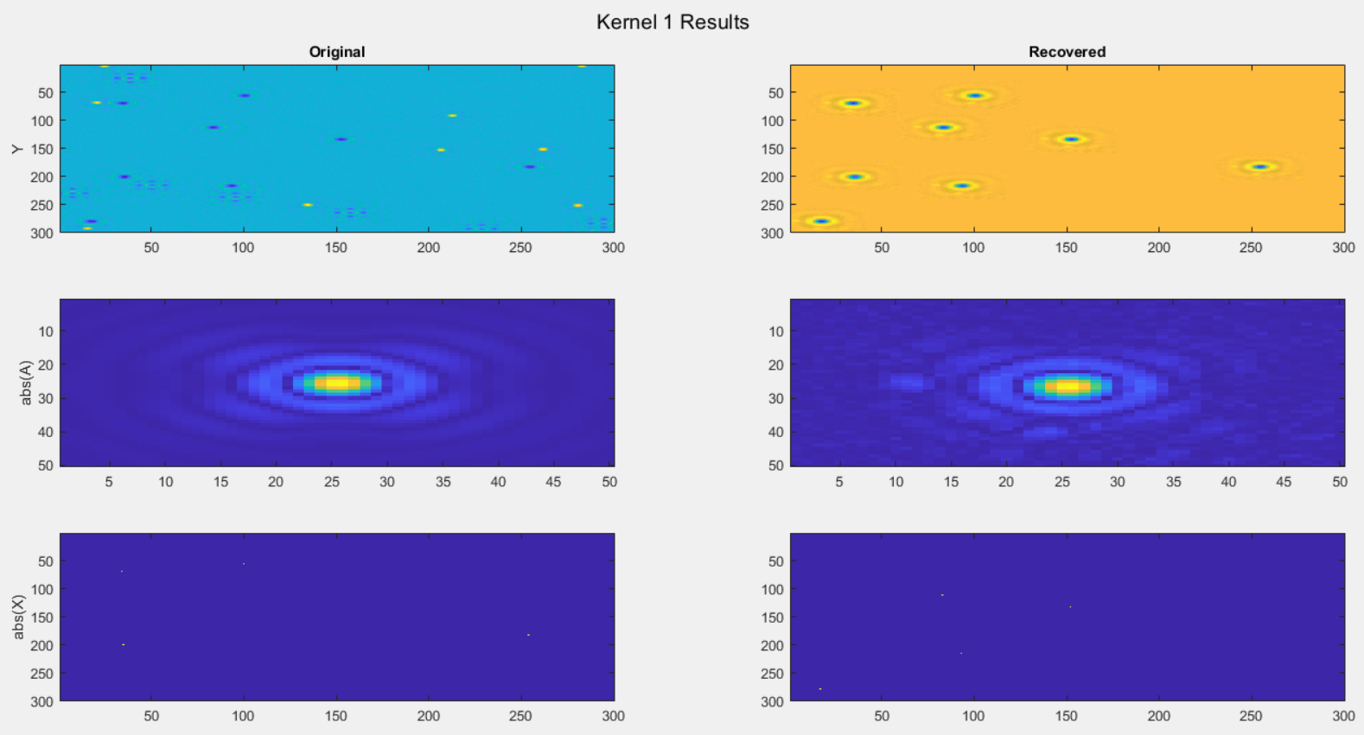
Scaling test:
MAXit = 100

Slide 24
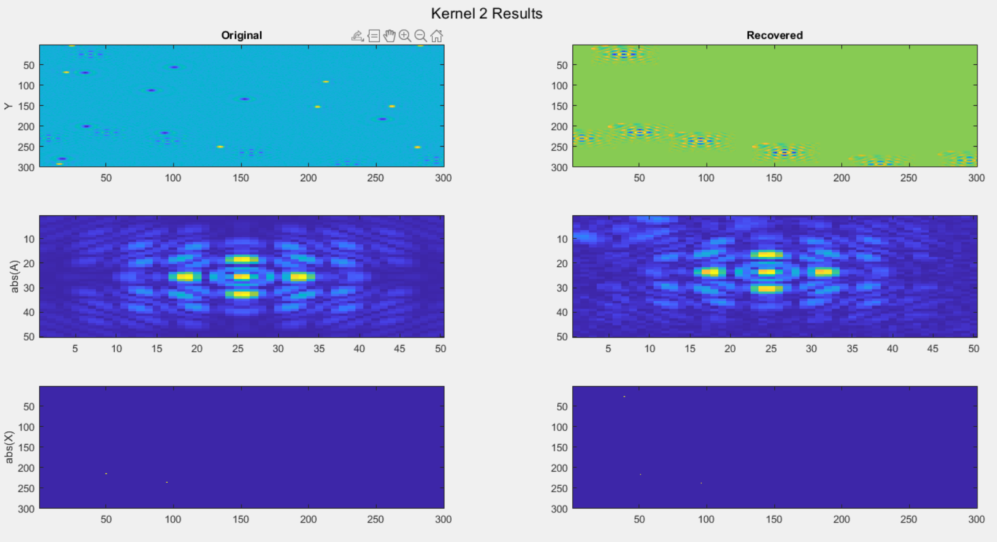
Scaling test:
MAXit = 100

Slide 25

Scaling test:
MAXit = 100

Slide 26
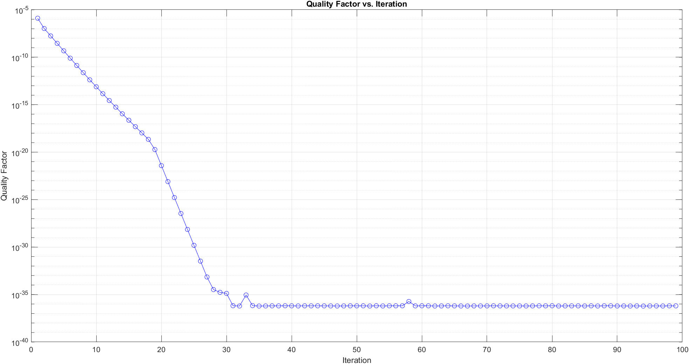
Scaling test:
MAXit = 100

Slide 28
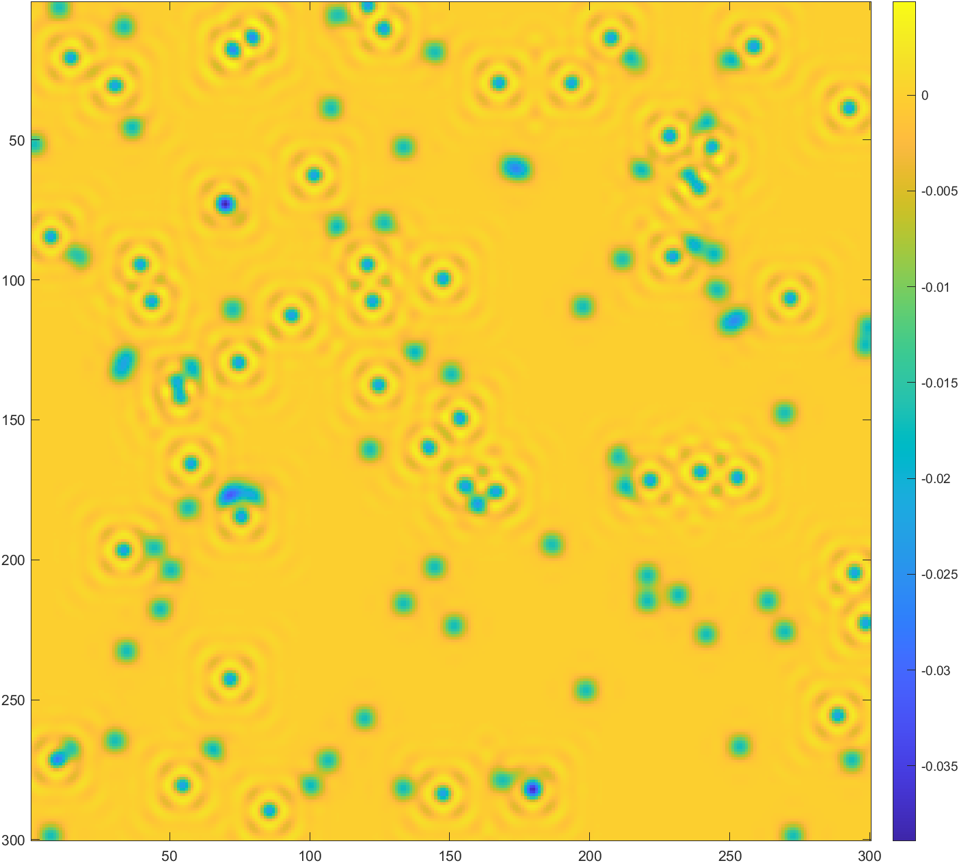
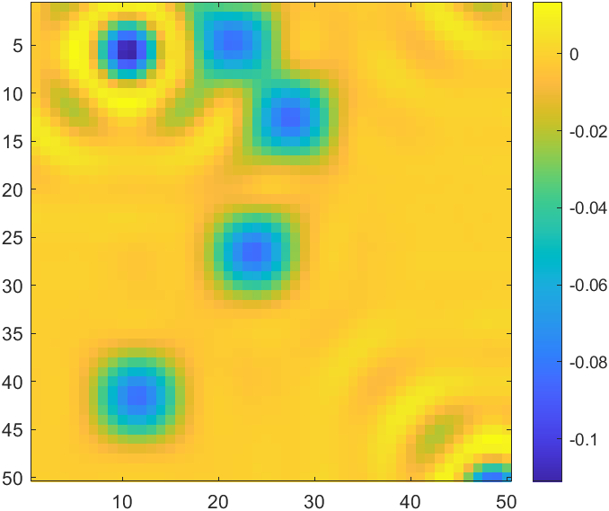
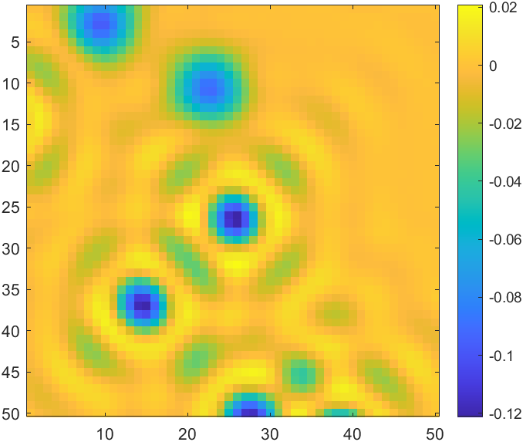
Noise_free
SNR=10000, dense, test
Initial guesses

Slide 29
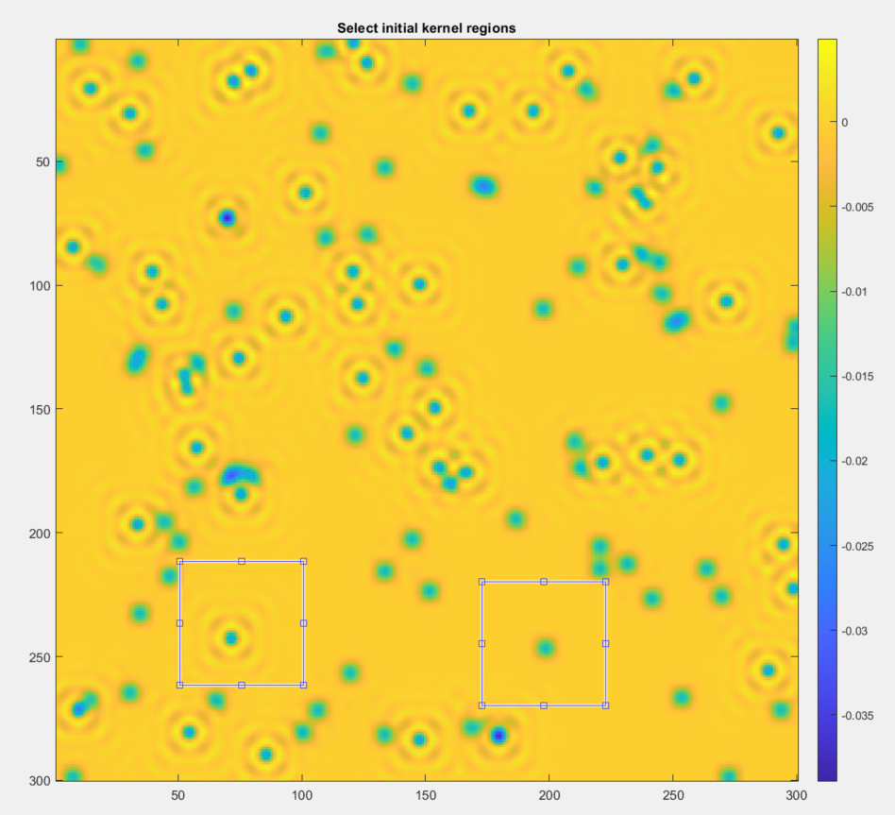
Noise_free
SNR=10000, dense, test
Initial guesses
Kernel 2
Kernel 1

Slide 30
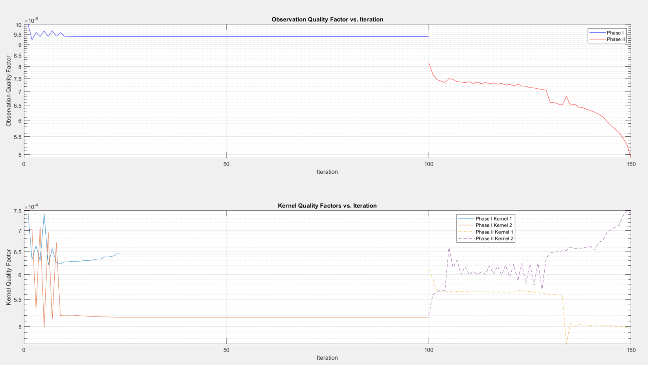
Noise_free SNR=10000, dense, test

Slide 31
Scaling test:
MAXit = 100

